Slide 1

Chapter 4
IoT System Management with NETCONF-YANG
Book website: http://www.internet-of-things-book.com
Bahga & Madisetti, © 2015

Slide 2
Outline
Need for IoT systems management
SNMP
Network operator requirements
NETCONF
YANG
IoT systems management with NETCONF-YANG
Book website: http://www.internet-of-things-book.com
Bahga & Madisetti, © 2015

Slide 3
Need for IoT Systems Management
Automating configuration
Monitoring operational and statistical data
Improved reliability
System-wide configuration
Multiple system configuration
Retrieving and reusing configurations
Book website: http://www.internet-of-things-book.com
Bahga & Madisetti, © 2015

Slide 4
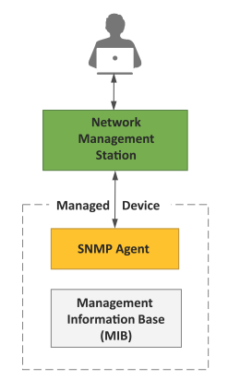
Simple Network Management Protocol (SNMP)
SNMP is a well-known and widely used network management protocol that allows monitoring and configuration of network devices such as routers, switches, servers, printers, etc.
SNMP component include
Network Management Station (NMS)
Managed Device
Management Information Base (MIB)
SNMP Agent that runs on the device
Book website: http://www.internet-of-things-book.com
Bahga & Madisetti, © 2015

Slide 5
Limitations of SNMP
SNMP is stateless in nature and each SNMP request contains all the information required to process the request. The application needs to be intelligent to manage the device.
SNMP is a connectionless protocol which uses UDP as the transport protocol, making it unreliable as there is no support for acknowledgement of requests.
MIBs often lack writable objects without which device configuration is not possible using SNMP.
It is difficult to differentiate between configuration and state data in MIBs.
Retrieving the current configuration from a device can be difficult with SNMP.
Earlier versions of SNMP did not have strong security features.
Book website: http://www.internet-of-things-book.com
Bahga & Madisetti, © 2015

Slide 6
Network Operator Requirements
Ease of use
Distinction between configuration and state data
Fetch configuration and state data separately
Configuration of the network as a whole
Configuration transactions across devices
Configuration deltas
Dump and restore configurations
Configuration validation
Configuration database schemas
Comparing configurations
Role-based access control
Consistency of access control lists
Multiple configuration sets
Support for both data-oriented and task-oriented access control
Book website: http://www.internet-of-things-book.com
Bahga & Madisetti, © 2015

Slide 7
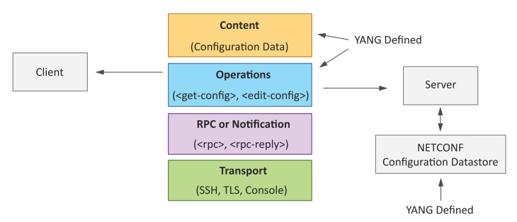
NETCONF
Network Configuration Protocol (NETCONF) is a session-based network management protocol. NETCONF allows retrieving state or configuration data and manipulating the configuration data on network devices.
Book website: http://www.internet-of-things-book.com
Bahga & Madisetti, © 2015

Slide 8
NETCONF
NETCONF works on SSH transport protocol.
Transport layer provides end-to-end connectivity and ensures reliable delivery of messages.
NETCONF uses XML-encoded Remote Procedure Calls (RPCs) for framing request and response messages.
The RPC layer provides a mechanism for encoding of RPC calls and notifications.
NETCONF provides various operations to retrieve and edit configuration data from network devices.
The Content Layer consists of configuration and state data which is XML-encoded.
The schema of the configuration and state data is defined in a data modelling language called YANG.
NETCONF provides a clear separation of the configuration and state data.
The configuration data resides within a NETCONF configuration data store on the server.
Book website: http://www.internet-of-things-book.com
Bahga & Madisetti, © 2015

Slide 9
YANG
YANG is a data modelling language used to model configuration and state data manipulated by the NETCONF protocol
YANG modules contain the definitions of the configuration data, state data, RPC calls that can be issued and the format of the notifications.
YANG modules define the data exchanged between the NETCONF client and server.
A module comprises a number of 'leaf' nodes which are organized into a hierarchical tree structure.
The 'leaf' nodes are specified using the 'leaf' or 'leaf-list' constructs.
Leaf nodes are organized using 'container' or 'list' constructs.
A YANG module can import definitions from other modules.
Constraints can be defined on the data nodes, e.g. allowed values.
YANG can model both configuration data and state data using the 'config' statement.
Book website: http://www.internet-of-things-book.com
Bahga & Madisetti, © 2015

Slide 10
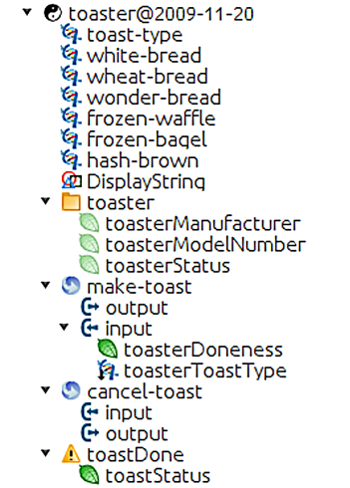
YANG Module – Example
This YANG module is a YANG version of the toaster MIB.
The toaster YANG module begins with the header information followed by identity declarations which define various bread types.
The leaf nodes (‘toasterManufacturer’, ‘toasterModelNumber’ and oasterStatus’) are defined in the ‘toaster’ container.
Each leaf node definition has a type and optionally a description and default value.
The module has two RPC definitions (‘make-toast’ and ‘cancel-toast’).
Book website: http://www.internet-of-things-book.com
Bahga & Madisetti, © 2015

Slide 11
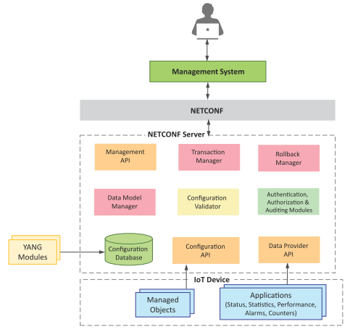
IoT Systems Management with NETCONF-YANG
Management System
Management API
Transaction Manager
Rollback Manager
Data Model Manager
Configuration Validator
Configuration Database
Configuration API
Data Provider API
Book website: http://www.internet-of-things-book.com
Bahga & Madisetti, © 2015

